Slide 1









My Number Interactive Notebook
$$×$$
$$\frac{1}{2}$$
$$÷$$
$$+$$
$$−$$
$$\frac{3}{5}$$
$$7$$
Name
Class
Teacher
Term 1 Semester 1
$$5^{2}$$
$$\sqrt{9}$$
1

Slide 2
Contents
Glossary or Formula Page
Page
Date
Description
2
3

Slide 3
Tasks
24
7
30
Essential Question
Questions
Notes
Summary

Slide 4
24
7
30
Date
Percentages
EQ – How do I calculate percentages of amounts without a calculator?
What is a percentage?

Slide 5
24
7
30
Date
Percentages
EQ – How do I calculate percentages of amounts without a calculator?
What is a percentage?
Percent means out of 100

Slide 6
Copy and Complete
Percentage | Fraction | Decimal
1%
10%
25%
50%
75%
100%

Slide 7
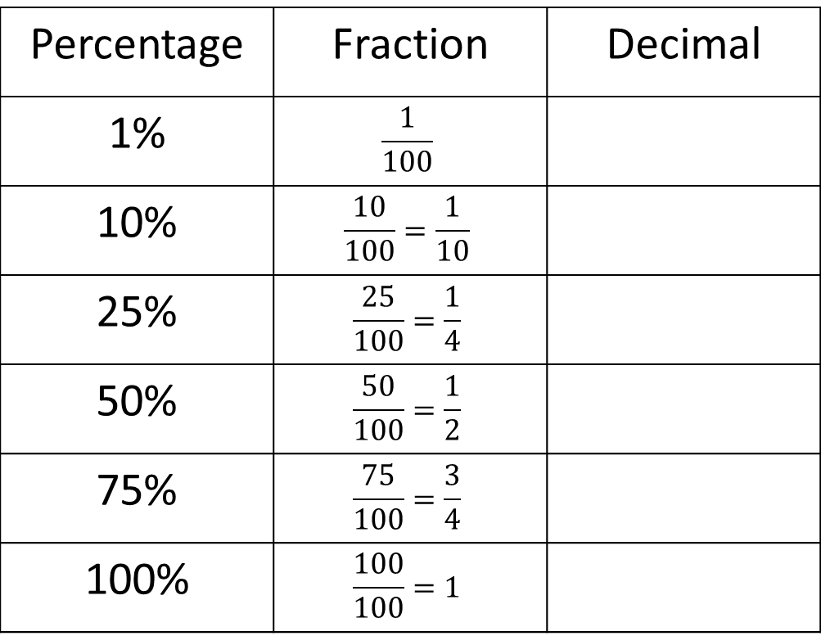
Copy and Complete
Percentage | Fraction | Decimal
1% | $$\frac{1}{100}$$
10% | $$\frac{10}{100}=\frac{1}{10}$$
25% | $$\frac{25}{100}=\frac{1}{4}$$
50% | $$\frac{50}{100}=\frac{1}{2}$$
75% | $$\frac{75}{100}=\frac{3}{4}$$
100% | $$\frac{100}{100}=1$$

Slide 8
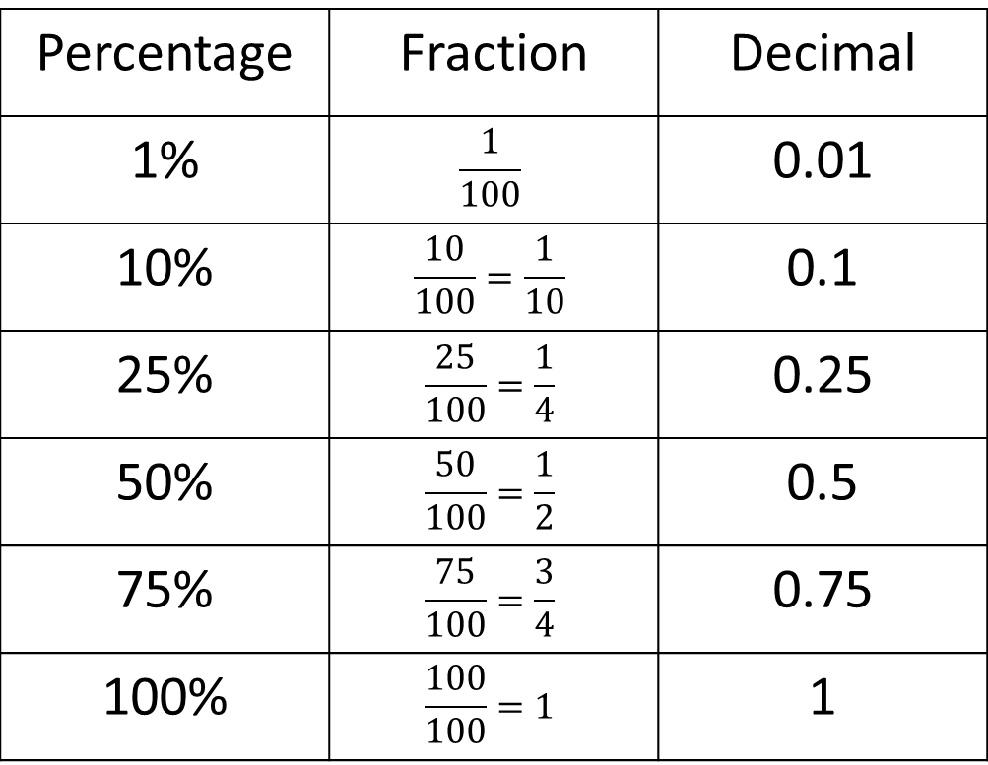
Copy and Complete
Percentage | Fraction | Decimal
1% | $$\frac{1}{100}$$ | 0.01
10% | $$\frac{10}{100}=\frac{1}{10}$$ | 0.1
25% | $$\frac{25}{100}=\frac{1}{4}$$ | 0.25
50% | $$\frac{50}{100}=\frac{1}{2}$$ | 0.5
75% | $$\frac{75}{100}=\frac{3}{4}$$ | 0.75
100% | $$\frac{100}{100}=1$$ | 1

Slide 9

24
7
30
Date
Percentages
EQ – How do I calculate percentages of amounts without a calculator?
What is a percentage?
Percent means out of 100
How do you find 1%?
1% = $\frac{1}{100}$ so to find 1% you divide by 100

Slide 10

24
7
30
Date
Percentages
EQ – How do I calculate percentages of amounts without a calculator?
What is a percentage?
Percent means out of 100
How do you find 1%?
1% = $\frac{1}{100}$ so to find 1% you divide by 100
How do I find 2%?
2% is double 1% so find 1% and then double

Slide 11
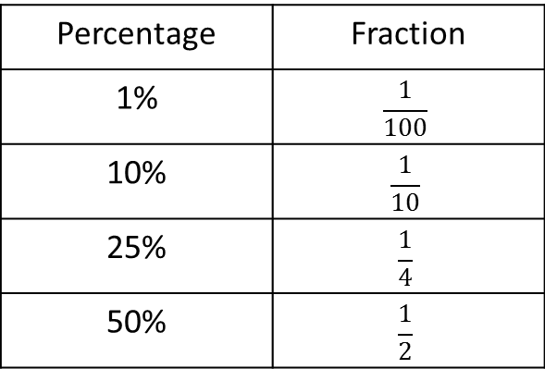
24
7
30
Date
Percentages
EQ – How do I calculate percentages of amounts without a calculator?
What is a percentage?
Percent means out of 100
How do you find 1%?
1% = $\frac{1}{100}$ so to find 1% you divide by 100
How do I find 2%?
2% is double 1% so find 1% and then double
How do I find any percentage?
Use the fraction to calculate the following %
Percentage | Fraction
1% | $$\frac{1}{100}$$
10% | $$\frac{1}{10}$$
25% | $$\frac{1}{4}$$
50% | $$\frac{1}{2}$$

Slide 12
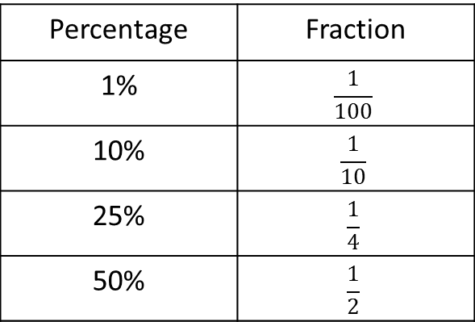

24
7
30
Date
Percentages
EQ – How do I calculate percentages of amounts without a calculator?
How do you find 1%?
1% = $\frac{1}{100}$ so to find 1% you divide by 100
How do I find 2%?
2% is double 1% so find 1% and then double
How do I find any percentage?
Use the fraction to calculate the following %
Percentage | Fraction
1% | $$\frac{1}{100}$$
10% | $$\frac{1}{10}$$
25% | $$\frac{1}{4}$$
50% | $$\frac{1}{2}$$
Use the answers to find the given percentage

Slide 13
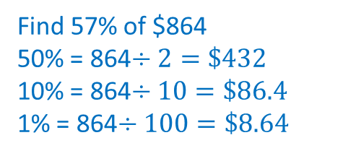
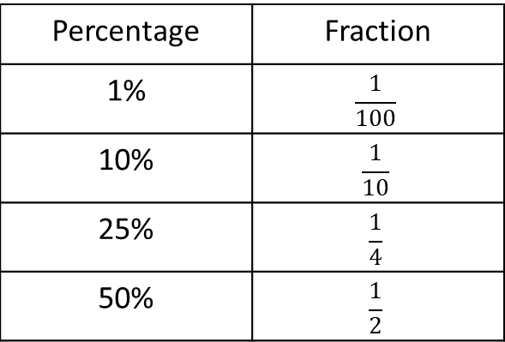
24
7
30
Date
Percentages
EQ – How do I calculate percentages of amounts without a calculator?
How do I find any percentage?
Use the fraction to calculate the following %
Percentage | Fraction
1% | $$\frac{1}{100}$$
10% | $$\frac{1}{10}$$
25% | $$\frac{1}{4}$$
50% | $$\frac{1}{2}$$
Use the answers to find the given percentage
Find 57% of $864
50% = 864$÷2=\$432$
10% = 864$÷10=\$86.4$
1% = 864$÷100=\$8.64$
Example

Slide 14
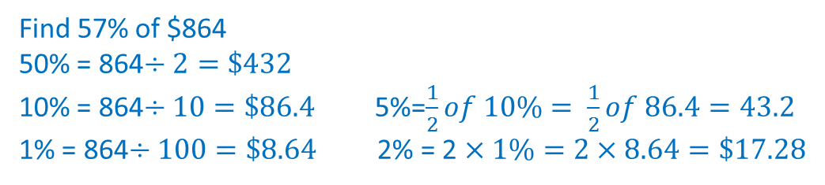
24
7
30
Date
Percentages
EQ – How do I calculate percentages of amounts without a calculator?
How do I find any percentage?
Use the fraction to calculate the following %
Percentage | Fraction
1% | $$\frac{1}{100}$$
10% | $$\frac{1}{10}$$
25% | $$\frac{1}{4}$$
50% | $$\frac{1}{2}$$
Use the answers to find the given percentage
Find 57% of $864
50% = 864$÷2=\$432$
10% = 864$÷10=\$86.4$ 5%=$\frac{1}{2}of 10\%= \frac{1}{2}of 86.4=43.2$
1% = 864$÷100=\$8.64$ 2% = 2 $×1\%=2×8.64=\$17.28$
Example

Slide 15
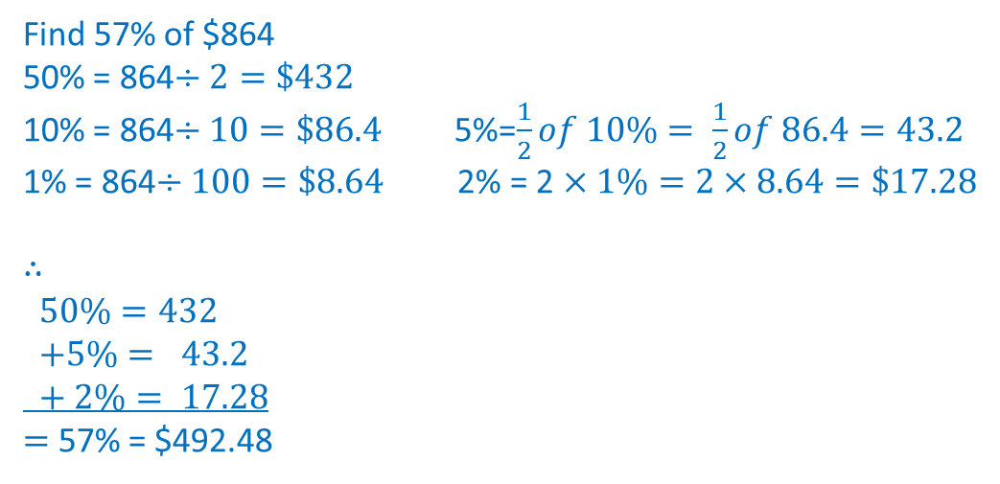
24
7
30
Date
Percentages
EQ – How do I calculate percentages of amounts without a calculator?
Find 57% of $864
50% = 864$÷2=\$432$
10% = 864$÷10=\$86.4$ 5%=$\frac{1}{2}of 10\%= \frac{1}{2}of 86.4=43.2$
1% = 864$÷100=\$8.64$ 2% = 2 $×1\%=2×8.64=\$17.28$
$$∴$$
$$50\%=432$$
$$+5\%= 43.2$$
$$+ 2\%= 17.28$$
$=$ 57% = $492.48
Example

Slide 16
Notes Review
24, 7 ,30
Date
Title
Essential question
Notes complete
Notes complete with colour and diagrams
Questions completed
Contents page filed in
Formula page filled in

Slide 17
Homework
Review your notes and write a summary answering the essential question.

